Slide 1
Social Desirability Bias
Jacob

Slide 2
Definition
“[T]endency to answer questionnaires or surveys according to what is socially acceptable” (Stephanie)
Politically correct or popular answer

Slide 3
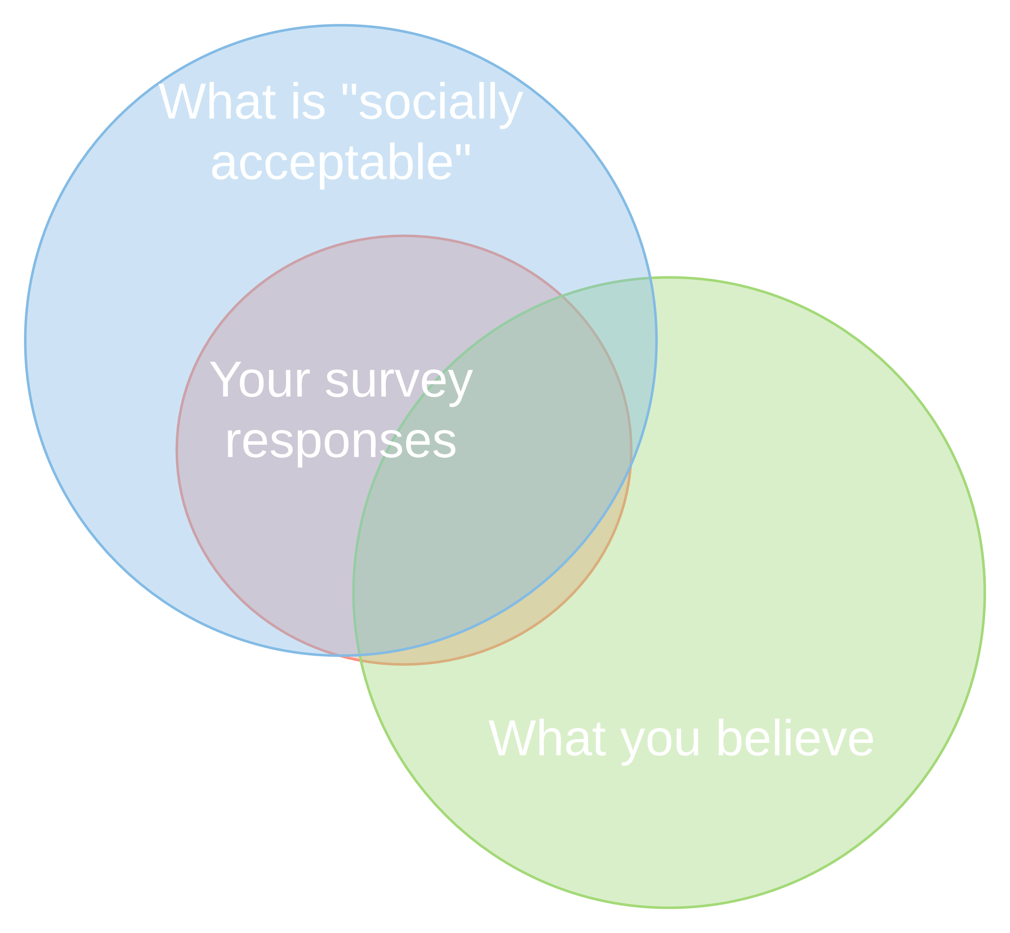
Graphic

Slide 4
Example 1
Inaccurate survey topics: abortion, drug use, or prostitution
Attributed to: embarrassment or lack of comfort in revealing true feelings or attitudes (Stephanie)

Slide 5
Other Instances
Personal income and earnings, often inflated when low and deflated when high [towards average]
Compliance with medicinal dosing schedules, often inflated
Involves self-deception

Slide 6
Solutions
Neutral questions
Bogus pipeline
Pseudo lie detector
Self administration
Forced choice items
Must pick a descriptive answer, but can force incorrect answers (Forced Choice)
Proxy subjects
Ask your friends about you (Nederhof)

Slide 7
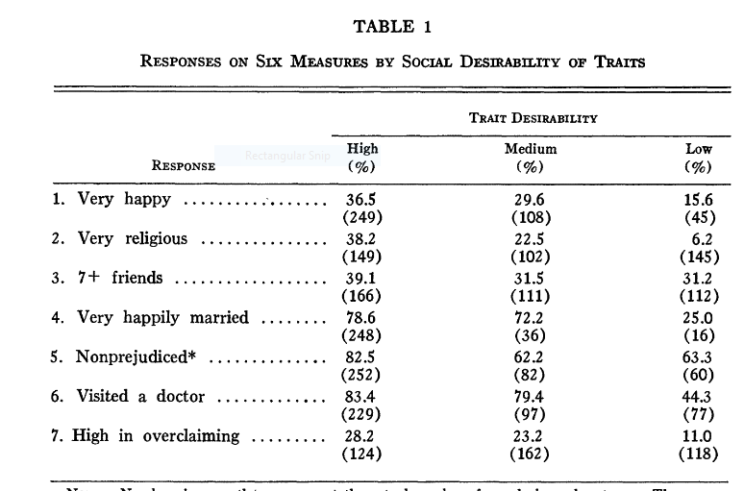
Study (Phillips & Clancy)

Slide 8
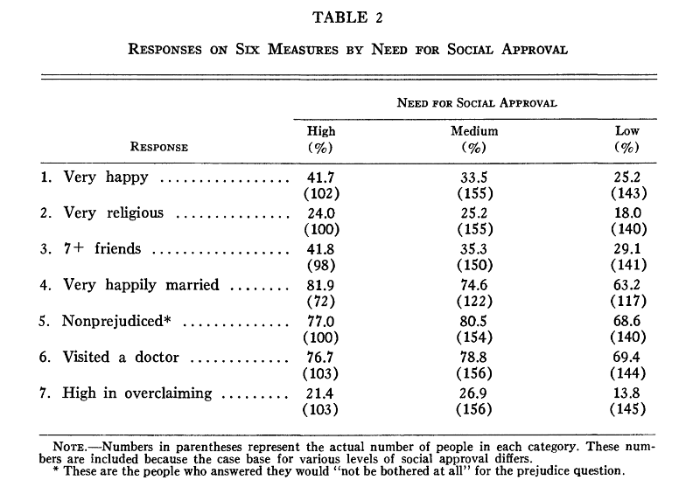
Study (Phillips & Clancy)

Slide 9
Bibliography
Forced Choice. (2008). In P. Lavrakas, Encyclopedia of Survey Research Methods. 2455 Teller Road, Thousand Oaks California 91320 United States of America: Sage Publications, Inc. https://doi.org/10.4135/9781412963947.n193
Lavrakas, P. (2008). Encyclopedia of Survey Research Methods. 2455 Teller Road, Thousand Oaks California 91320 United States of America: Sage Publications, Inc. https://doi.org/10.4135/9781412963947
Nederhof, A. J. (1985). Methods of coping with social desirability bias: a review. European Journal of Social Psychology, 15(3), 263–280.
Phillips, D. L., & Clancy, K. J. (1972). Some Effects of “Social Desirability” in Survey Studies. American Journal of Sociology, 77(5), 921–940.
Social desirability bias. (2018, January 11). In Wikipedia. Retrieved from https://en.wikipedia.org/w/index.php?title=Social_desirability_bias&oldid=819810226
Stephanie. (n.d.). Bias in Statistics: Definition, Selection Bias & Survivorship Bias. Retrieved January 25, 2018, from http://www.statisticshowto.com/what-is-bias/

